Slide 1
Using Session Control in PHP

Slide 2
What is session control?
Cookies
Session
Sessions and authentication

Slide 3
Cookie
A cookie is a small piece of information that scripts can store on a client-side machine.
Cookies data is sent along with the HTTP headers.
After the first visit to any web site, the browser returns a copy of the cookie to the server each time it connects.
For security reasons, cookies can be read only from the domain that created them.
Cookies have an expiration date after which they’re deleted.
The maximum size of data that a cookie can hold is 4 KB.

Slide 4

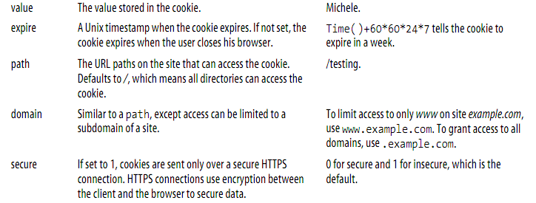
Setting a Cookie
setcookie ( name , value , expire , path, domain , secure )

Slide 5
Setting a Cookie
<?php
//Remember that setcookie must come before any other line that generates output
setcookie("username","michele");
echo 'Cookie created.';
?>

Slide 6
Accessing a Cookie
<?php
if (!isset($_COOKIE['username'])){
echo ("Oops, the cookie isn't set!");
}
else{
echo ("The stored username is ". $_COOKIE['username'] . ".");
}
?>
You can also see all cookies by accessing the super global variable $_SERVER[HTTP_COOKIE].

Slide 7
Destroying a Cookie
Cookies can be destroyed or deleted by the client or the server.
Clients can easily delete their cookies by locating the Cookies folder on their system and deleting them.
The server can delete the cookies by:
Resetting a cookie by specifying an expiration time
Resetting a cookie by specifying its name only
<?php
//Remember that setcookie must come before any other line that generates output
setcookie("username","", time( )-10 );
?>

Slide 8
What Is Session Control?
HTTP is a stateless protocol.
The protocol has no built-in way of maintaining state between two transactions.
When a user requests one page, followed by another, HTTP does not provide a way for you to tell that both requests came from the same user
→ HTTP and web servers don’t keep track of information that was entered on a page when the client’s browser loads another page.
This makes doing anything that involves using the same information from a user on several pages difficult.

Slide 9
Session
Sessions help solve this problem by maintaining data during a user’s visit to your web site from page to page.
The idea of session control is to be able to track a user during a single session on a website.
If you can do this, you can easily support logging in a user and showing content according to her authorization level

Slide 10
Session
Sessions in PHP are driven by a unique session ID, a cryptographically random number.
This session ID is generated by PHP and stored on the client side for the lifetime of a session.
It can be either stored on a user’s computer in a cookie or passed along through URLs.
if you set the session.use_trans_sid directive in the php.ini file. It is off by default.
The session ID acts as a key that allows you to register particular variables as so-called session variables.
The contents of these variables are stored at the server. The session ID is the only information visible at the client side.

Slide 11
Implementing Simple Sessions
The basic steps of using sessions are
Starting a session
Registering session variables
Using session variables
Deregistering variables and destroying the session
Note that these steps don’t necessarily all happen in the same script, and some of them happen in multiple scripts. Let’s examine each of these steps in turn.

Slide 12
Starting a Session
Sintax: session_start();
This function checks to see whether there is already a current session.
If not, it will essentially create one, providing access to the superglobal $_SESSION array.
If a session already exists, session_start() loads the registered session variables so that you can use them.
It’s essential to call session_start() at the start of all your scripts that use sessions. If this function is not called, anything stored in the session will not be available to this script.

Slide 13
Registering Session Variables
Session variables have been stored in the superglobal array $_SESSION since PHP 4.1.
To create a session variable, you simply set an element in this array, as follows:
$_SESSION[‘myvar’] = 5;
The session variable you have just created will be tracked until the session ends or until you manually unset it.

Slide 14
Using Session Variables
You can then access the variable via the $_SESSION superglobal array, for example:
$_SESSION[‘myvar’].
On the other hand, you need to be careful when checking whether session variables have been set or not.
You can check this directly using the following, for example:
if (isset($_SESSION[‘myvar’])) ...

Slide 15
Unsetting Variables and Destroying the Session
When you are finished with a session variable, you can unset it. You can do this directly by unsetting the appropriate element of the $_SESSION array, as in this example:
unset($_SESSION[‘myvar’]);
To unset all the session variables at once, use
$_SESSION = array();
When you are finished with a session, you should first unset all the variables and then call
session_destroy();
to clean up the session ID.

